Slide 1
Digital Citizenship Well-being
Created by Alife.R, Sam.F, Nina.F, Mya.N, Adam.M Josh.Y

Slide 2
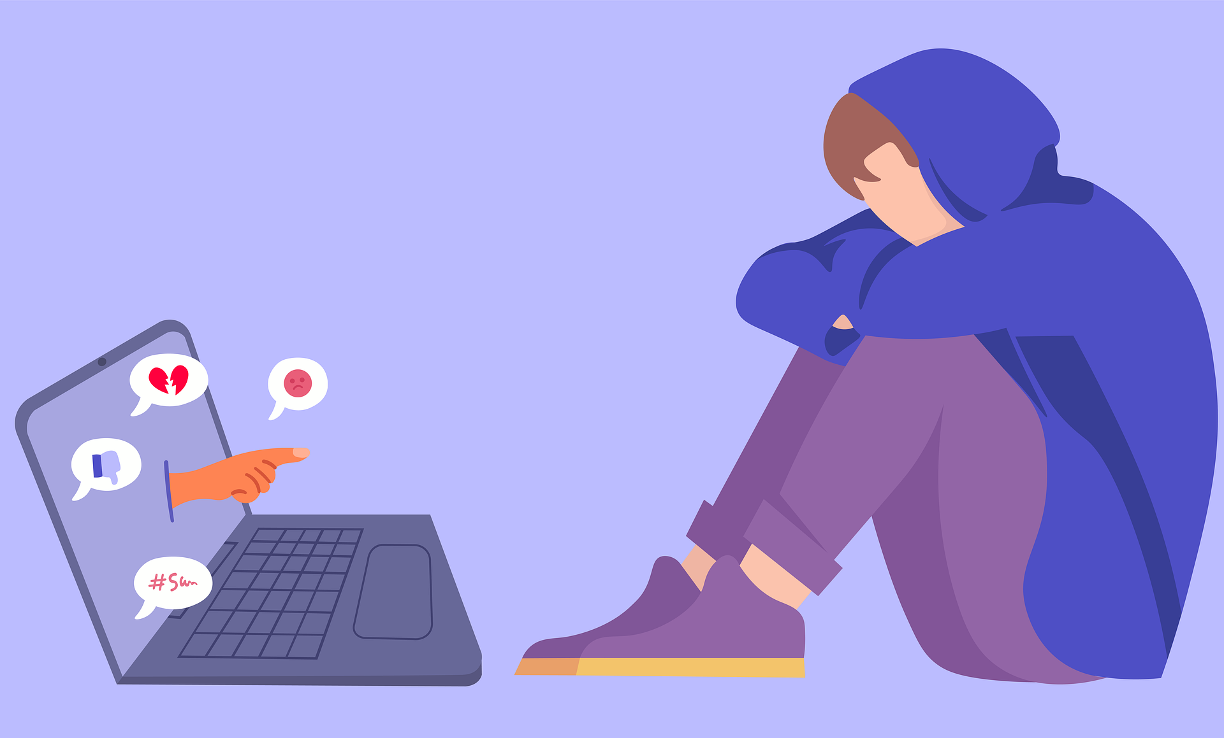
Cyber bullying.
Cyber bullying is a terrible thing. It is a massive global problem throughout the world and is illegal in many countries. Playing games or using social media puts you at risk of witnessing or experiencing this.

Slide 3

Inappropriate content
Unfortunately even though there are regulations you might be watching if you watch YouTube or other digital content there could be very inappropriate content.
It could be rude behaviour, swearing and might make you think it’s right.
You may come across inappropriate content that could be harmful to your physical and mental health.

Slide 4
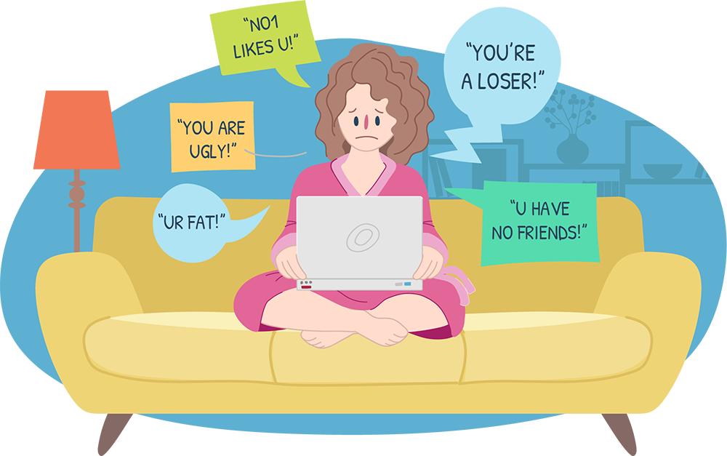
What to do!
Tell a adult and they should deal with it.
Report it to content provider and block it.
If needed report it to the police by taking a screenshot, with an adults help.
If you or someone are in immediate danger call 999

Slide 5

What are you going to do to prevent yourself from these digital threats?
Let’s do all we can to live safe, healthy and happy online.
Wonderful creatures of this slideshow are Alfie, Adam, Sam, Mya, Nina and Josh.

Slide 6


