Slide 1
How to be safe on the internet!
Made by the year 6 digital leaders Nate , Evie, Oliver, . Noah Fraser, Harry.

Slide 2

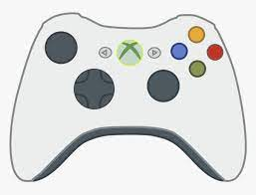

What do you use the internet for?
Watching TV shows
Watching videos
Playing games
Finding things out
Learning at home
Reading

Slide 3
Staying safe on the internet!
If you see a pop up that looks wrong then check with a grown up before doing anything!
Never ever tell people on the internet your name, where you live or which school you go to.
Always ask a grown-up before you go onto the Internet.
Remember not all the things on the Internet are for children .
Just like in the real world, the internet has people who can be both kind and unkind using it.

Slide 4
How can we use the Internet but still stay safe?
Always tell a grown up when you are using the internet and let them help you to choose safe websites.
Always tell a grown up if someone you don’t know sends you a message or tries to speak to you on the internet.

Slide 5
Be SMART when using the internet
S: Stay safe, don't tell a person you don’t know your name, where you live or passwords
M: Meeting, It is dangerous to meet someone that you have talked to online but never met.
A: Accepting, Don't click on messages or pictures they may contain inappropriate (bad) information.
R. Reliability, just because it’s on the internet does not mean its true and only talk to friends and family.
T. Tell, If anything happens that makes you feel worried when using the internet, you need to tell a trusted adult

Slide 6
Fun facts
No one actually owns the whole internet.
THe internet can be used by anyone in the whole world.
No one decides what can be put on the internet so not everything on the internet is true.

Slide 7

Does anyone have any questions?
Thanks for listening!.
WE all hope you learnt .something today!

