Slide 1
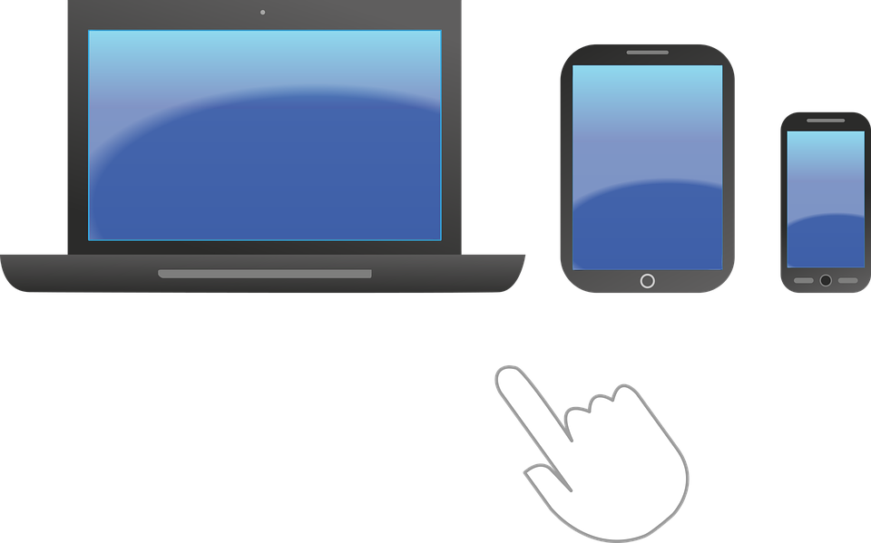
How to stay safe on the internet.

Slide 2
What is the internet?
The internet is an interconnected network of computers
All around the world there are billions of computers connected by wi-fi and cables that share information between each other
You can get onto the Internet using a laptop, a computer, a tablet and even a mobile phone!

Slide 3
What
do you use the internet for?
You can have a lot of fun on the internet and learn about lots of interesting things
Watching tv shows
Watching videos
Playing games
Finding things out
Learning at home

Slide 4
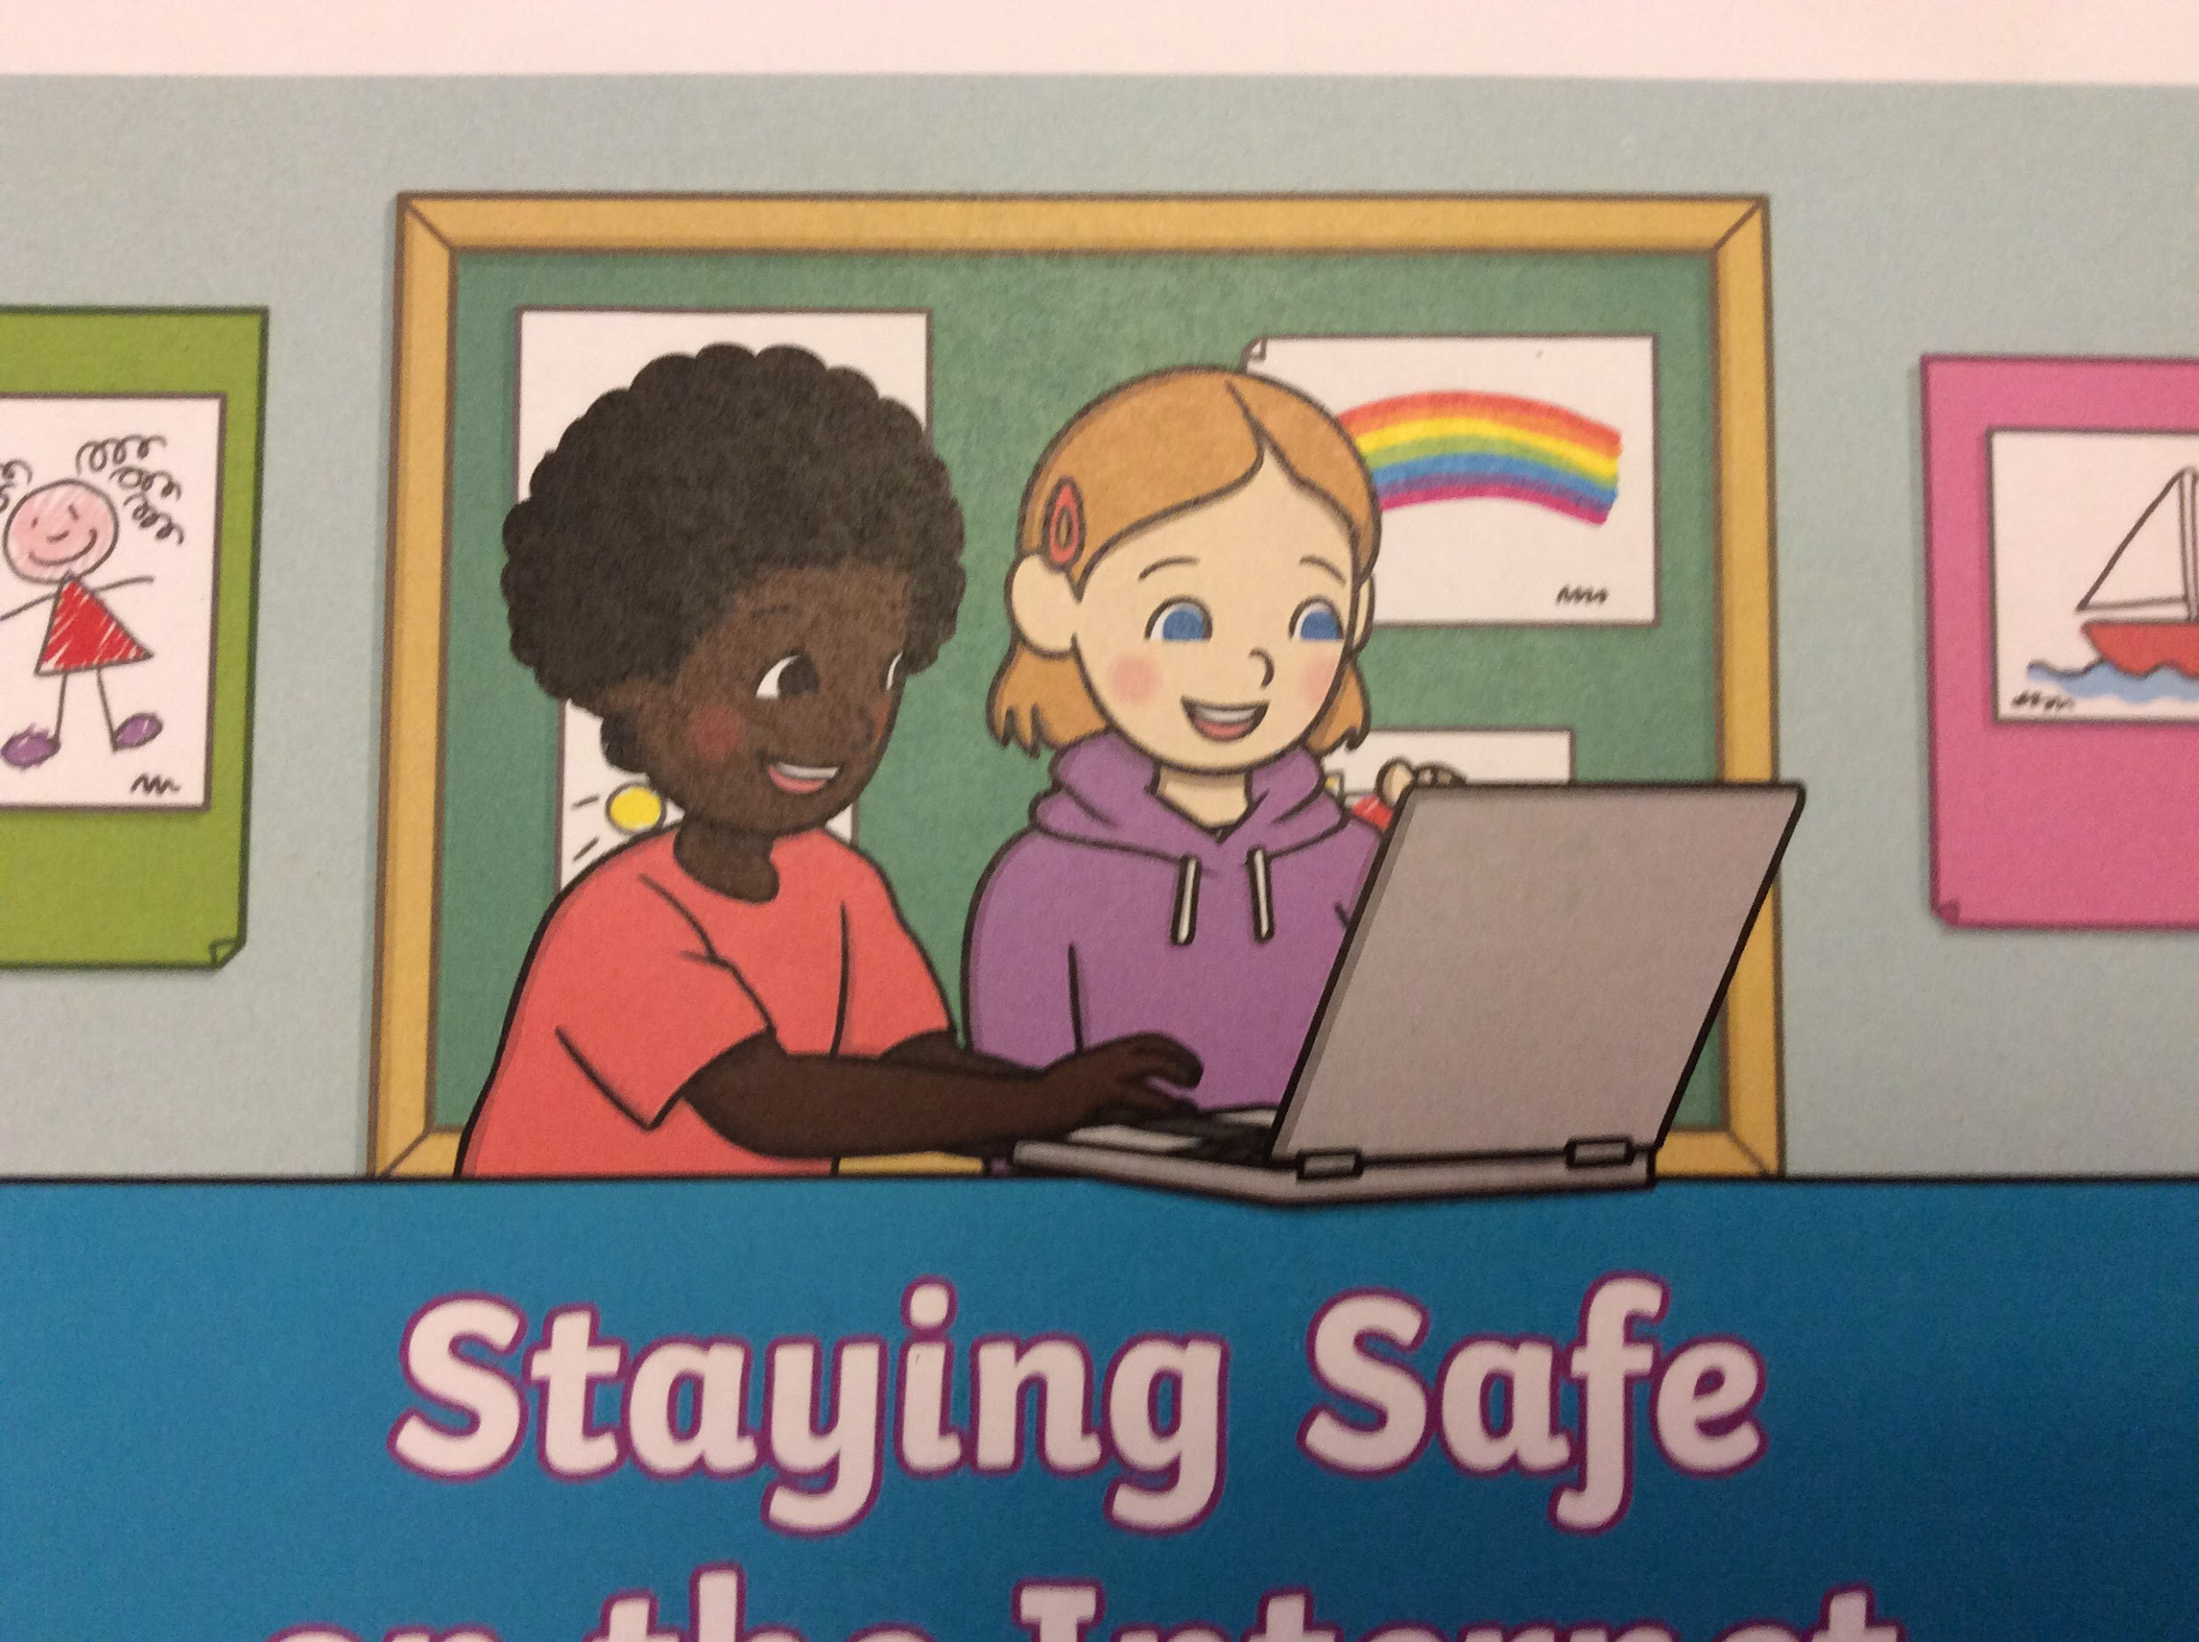


How to stay safe on the internet!
Always ask a grown up before going on the internet.
Always check with a grown up if you want to try new websites.
No one owns the internet so not everything is suitable.

Slide 5



Staying safe on the internet!
Sometimes things pop up on your screen.
Never click on these adverts that don’t look suitable As a example of a advert
Tell an adult if this happens.

Slide 6


Staying safe on the internet!
You wouldn’t talk to a stranger in real life so don’t do it online.
Never tell people your name, where you live or your school
If anyone tries to talk to you tell a grown up.

Slide 7
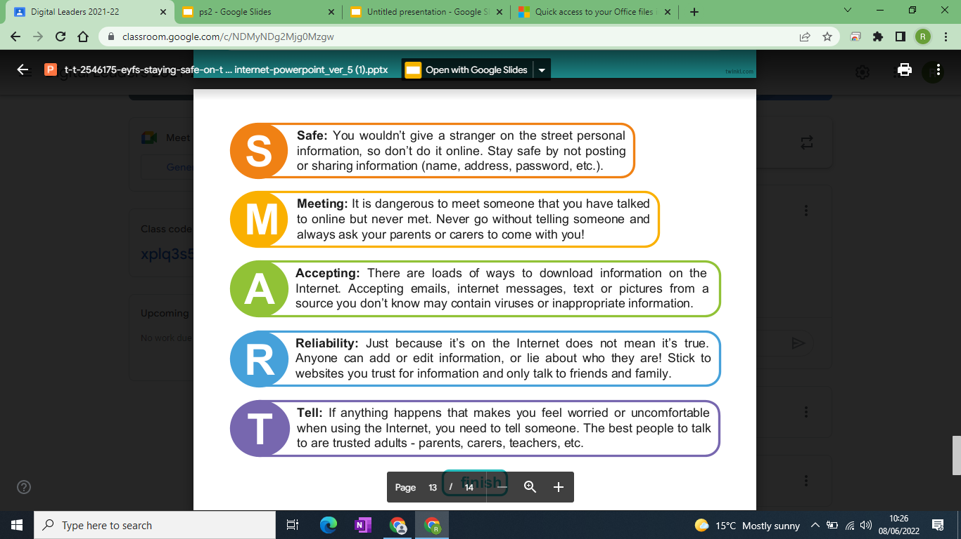

Slide 8
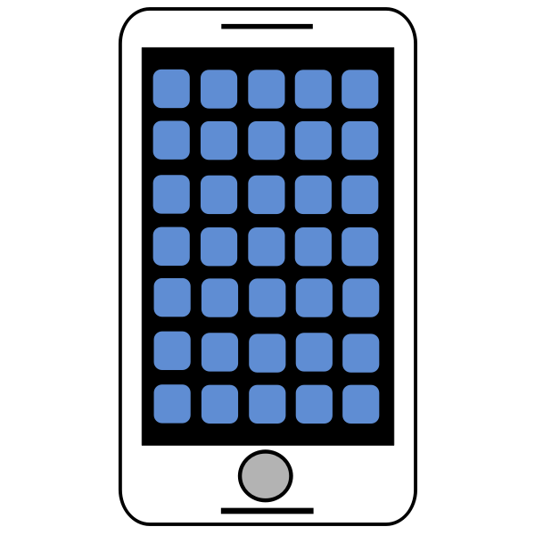

Thank you for your time now you should never bullyonline

